Slide 1


The Making Of My Database Final Project
Created By: Jeremy Whitenect

Slide 2
Arguably The Most Important Part: The Program
For the first time in this course, it is the optimal choice to not use the online SQL editor we have been using.
There are many different SQL editors due to the popularity of the language, you could even use notepad and just have the online editor for testing.
I personally opted to go with MySQL Workbench, it seemed very user friendly to me.
Although it was an option, I opted to not use the GUI to create tables as I believe it goes against the point.
However, I do understand why some would use it and I probably would have used it if I weren’t working on this project.

Slide 3
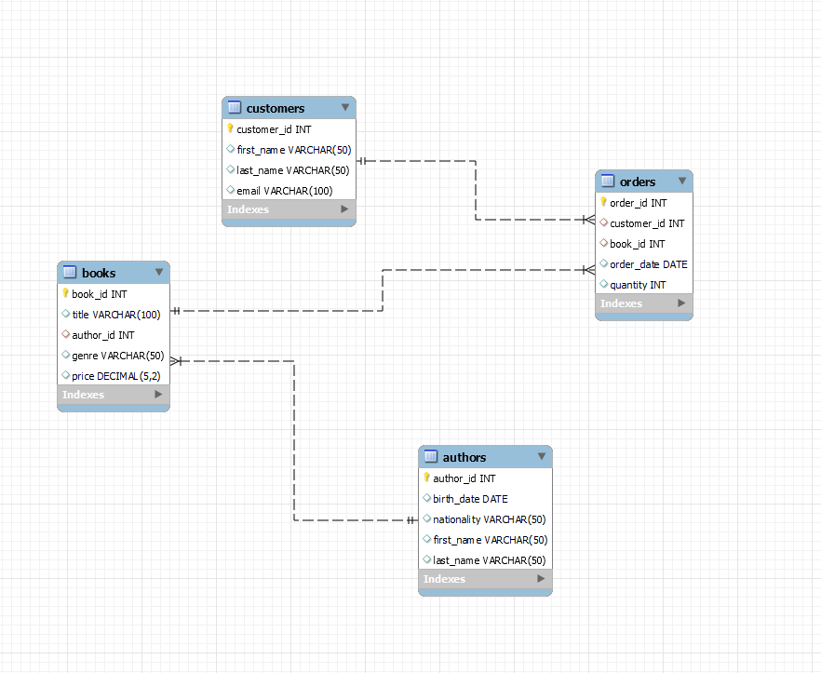
General Structure

Slide 4
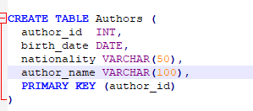
General Structure
As seen on the previous slide, that was the entity relationship diagram
This was the only feature I used in the GUI elements; it was quite a good one as I was able to create this after checking only a few boxes.
This was a great way for me to understand the general structure of the database before inputting data and created the queries we were instructed to create.
Tables were all created using the same format (seen here) with the CREATE TABLE function.

Slide 5
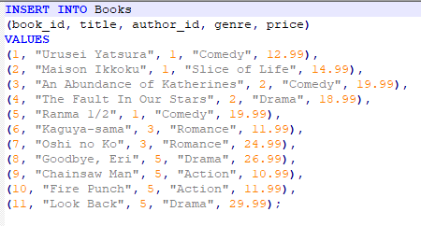
Data Insertion
Without data, there would be no queries, this is a key part of SQL.
Here is an example of one of the tables I inserted data into.
Because of its necessity, this is something that was easily done for all tables.

Slide 6
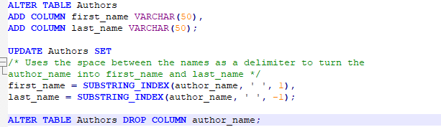
Normalization
There was one major aspect of this database that needed to be normalized.
The authors table had a field, “name” as opposed to the standard first name and last name fields you would expect.
But, since the first and last names were separated by a space, I was able to use that space as a delimiter to move the information into two fields.
All that needed to be done afterwards was to drop the original column.

Slide 7
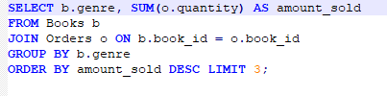
SQL Queries
From the non-advanced queries section, I would say that the one pictured here was the most difficult.
There were a lot of pieces to put together so to speak and because of that, I made an issue.
Originally, I had o.book_id as o.order_id and that went beyond my notice
The incorrect result did not go beyond my notice however, I spent an hour trying to find what was wrong.
Then, I happened to glance at it in just the right way, saw the issue and jumped for joy when it worked.

Slide 8

SQL Queries Cont.
The other queries went off without a hitch.
I would like to spotlight this one, however.
It was the only query in which the data had to be changed and I believe that to be interesting.
I decided to up the price of Comedy books because I thought it was funny (haha, get it?)
All the other queries were relatively simple, and it would be repetitious to go over all of them for the simple section.

Slide 9
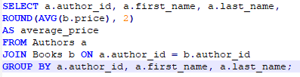
Advanced SQL Queries
The advanced section a.k.a just more queries!
This one here were I had to get the average price of books per author was the one that required the most thinking.
Like the one in the previous section, I knew the pieces, I just had to put them together in the right order.
I’d say this was easier than the one in which I made the mistake but if I didn’t make that mistake, I’d say this was harder.

Slide 10


Advanced SQL Queries Cont.
The other two queries in the advanced section were much easier.
Overall, it was like doing one query due to how similar they are.
Combined with the fact that I'd say they’re simpler than the previous one, these queries were a nice way to end things off.

Slide 11
Conclusion
There were some challenges as some of the more complicated queries required a bit of thinking and I had to weed out small errors that I had made.
But I got to learn a new SQL compiler because of the project which I am very thankful for, knew programs in my knowledge bank are always welcome.
If I had the choice, I think I would rearrange some of the queries in the standard and advanced sections because of my personal challenges but that may not apply to everyone.
In the end, I both enjoyed and was more frustrated than I expected but it was a nice experience, and I was able to learn more about SQL!

